Slide 1
LAN Devices

Slide 2
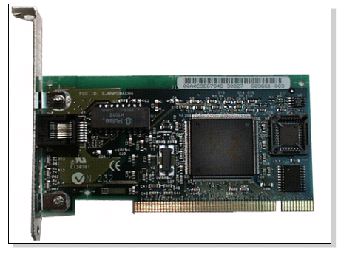
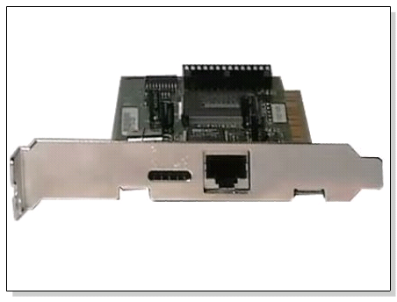
Network Interface Card
Also called Network Adapter
Connects a host to a network medium
Provides the physical interface between computer and cabling.
It prepares data, sends data, and controls the flow of data. It can also receive and translate data into bytes for the CPU to understand.
Contain unique MAC Address to control data communication
Transceiver may be used to connect to mismatched media type

Slide 3
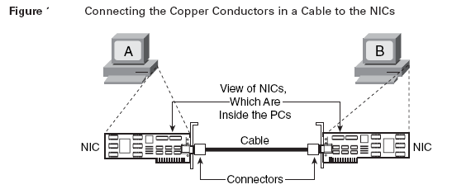

Slide 4
Network Devices
IEEE committee identified the following possible internetworking scenarios.
A single LAN
Two LANs connected together (LAN-LAN)
A LAN connected to a WAN (LAN-WAN)
Two LANs connected through a WAN (LAN-WAN-LAN)
Various internetworking devices such as hubs, bridges, switches, routers and gateways are required to link them together.

Slide 5

Repeaters
Repeater is a powerful network device which is used to increase the length of the network by eliminating the effect of attenuation on the signal.
A single Ethernet segment can have a maximum length of 500 meters with a maximum of 100 stations. To extend the length of the network, a repeater may be used
The purpose of the Ethernet repeater is to carry signal from one Ethernet cable and take it to the other cable without attenuation or loss of signal strength.
A repeater exists as the first layer of the OSI layer that is physical layer.
Repeaters require a small amount of time to regenerate the signal. This can cause a propagation delay.

Slide 6
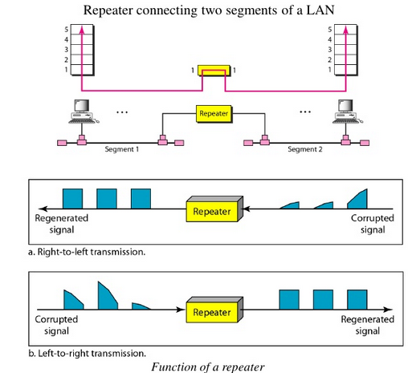
Repeaters

Slide 7
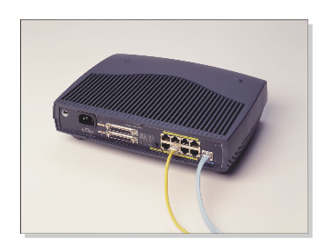
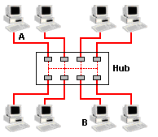
Hub
Multi-port repeaters with 4 to 24 ports (typical repeater usually has 2 ports)
It repeats what it receives on one port to all other ports, including the port on which the signal was received, so that the transmitting device may monitor and recover from collisions.
Converts the network to Star topology
Commonly used in 10Base-T and 100Base-T networks

Slide 8
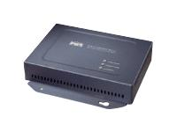
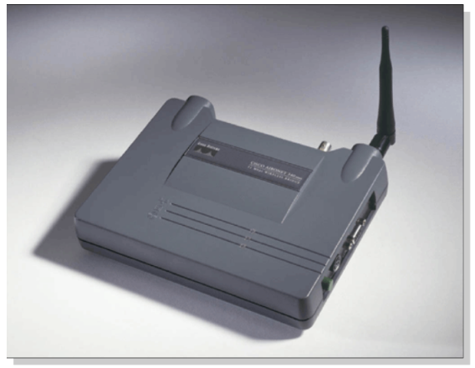
Bridges
The device that can be used to interconnect two separate LANs is known as a bridge.
It is commonly used to connect two similar or dissimilar LANs.
Operates in both the PHYSICAL and the data link layer.
As a PHYSICAL layer device, it regenerates the signal it receives.
As a data link layer device, the bridge can check the PHYSICAL/MAC addresses (source and destination) contained in the frame.

Slide 9
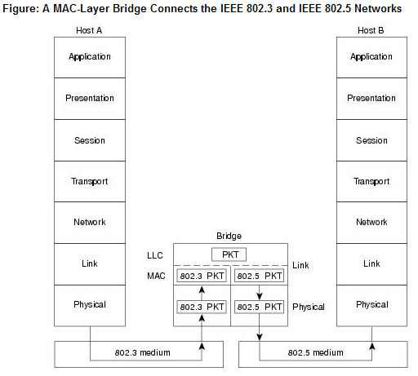
Translational Bridges
Notes:
The above figure illustrates an IEEE 802.3 host (Host A) formulating a packet that contains application information and encapsulating the packet in an IEEE 802.3-compatible frame for transit over the IEEE 802.3 medium to the bridge. At the bridge, the frame is stripped of its IEEE 802.3 header at the MAC sublayer of the link layer and is subsequently passed up to the LLC sublayer for further processing. After this processing, the packet is passed back down to an IEEE 802.5 implementation, which encapsulates the packet in an IEEE 802.5 header for transmission on the IEEE 802.5 network to the IEEE 802.5 host (Host B).

Slide 10
How Bridges Work?
A bridge has a table used in filtering decisions.
It can check the destination address of a frame and decide if the frame should be forwarded or dropped.
If the frame is to be forwarded, the decision must specify the port.
A bridge has a table that maps address to ports.
Bridges have three basic functions:
Forwarding a frame from one segment to another across the bridge.
Filtering a frame that does not need to cross the bridge to reach its destination.
Flooding a frame to all ports when the location of the destination address is unknown.
Increases network performance

Slide 11
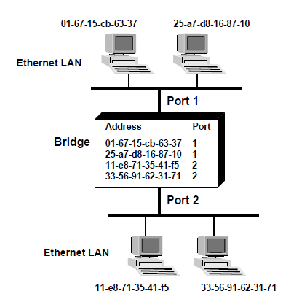
Transparent Learning Bridges Build Forwarding Tables
Notes:
The Basic Forwarding Process
When a bridge receives a frame, it compares the frame’s source and destination address with the addresses in the forwarding table. Depending on the results, the bridge performs the following actions:
• If the source address is not present in the forwarding table, the bridge adds the source address and corresponding interface to the table. It then checks the destination address to determine if it is in the table.
• If the destination address is listed in the table, it determines if the destination address is on the same LAN as the source address. If it is, then the bridge drops the frame since all the workstations have already received the frame.
• If the destination address is listed in the table but is on a different LAN than the source address, then the frame is forwarded to that LAN.
• If the destination address is not listed in the table, then the bridge forwards the frame to all the LANs except the one that which originally received the frame. This process is called flooding.

Slide 12
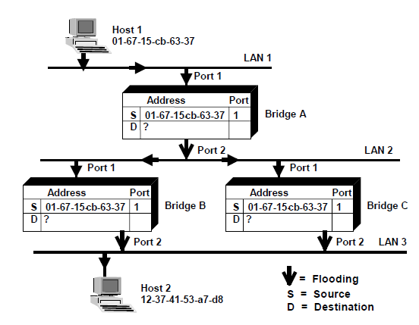
The Frame is Flooded Across the Network
Notes:
The Frame is Flooded Across the Network
1. Host 1 sends a frame out over LAN 1. Bridge A receives the frame on port #1.
2. Bridge A records the source address (01-67-15-cb-63-37) of the frame and the port number on which the frame was received (port 1).
3. Bridge A then looks for the destination address of the frame. If the destination address is not in the forwarding table prior to receiving the frame, the bridge floods the frame onto LAN 2.
4. Both Bridge B and Bridge C receive the frame. Both bridges record the source address and the port number on which the frame was received (port 1).
5. Since neither bridge has the destination address in their forwarding table they both flood the frame onto LAN 3. This results in two frames being sent onto LAN 3.
6. Host 2 receives the frame.

Slide 13
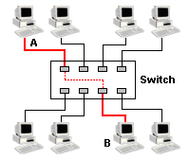
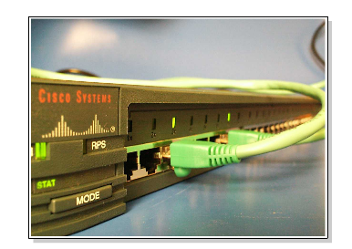
Switches
Sometimes called multi-port bridge
A switch is essentially a fast bridge having additional sophistication that allows faster processing of frames.
Improves congestion and reduce traffic

Slide 14
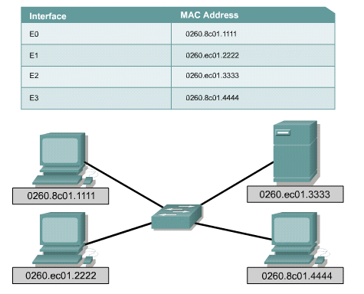
Switching Table

Slide 15
Advantages of Switch
Switches operate at much higher speeds than bridges
Can support new functionality, such as Virtual LANs.
Allows multiple users to communicate at the same time through Virtual circuits and dedicated network segments
Crates Virtually Collision free environment
Improves network speed, bandwidth and performance
Very cost effective since the hardware and cables in place can be reused

Slide 16
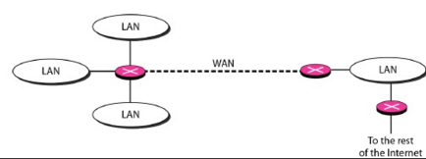
Router
Also called 3-layer switches
Routes packets based on their logical addresses (host-to-host addressing) .
A router normally connects LANs and WANs in the Internet and has a routing table that is used for making decision about the route.
The routing tables are normally dynamic and are updated using routing protocols.

Slide 17
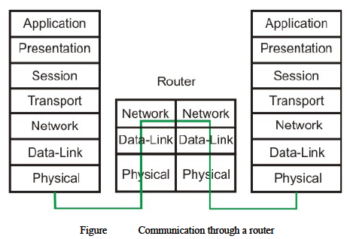

Slide 18
Gateway
A gateway is a hardware device that acts as a "gate" between two networks.
It may be a router, firewall, server, or other device that enables traffic to flow in and out of the network.
A router is a common type of gateway used in home networks. It allows computers within the local network to send and receive data over the Internet.
A firewall is a more advanced type of gateway, which filters inbound and outbound traffic, disallowing incoming data from suspicious or unauthorized sources.
A proxy server is another type of gateway that uses a combination of hardware and software to filter traffic between two networks. For example, a proxy server may only allow local computers to access a list of authorized websites.
Gateways can operate at all layers of the OSI model

Slide 19
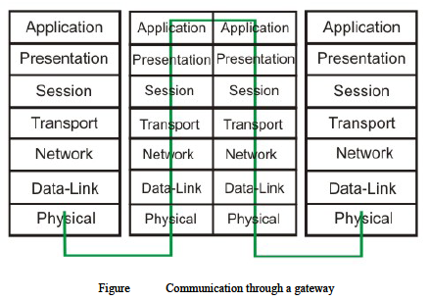
Notes:
Gateway A gateway is a node on a network that serves as an entrance to another network. The gateway routes traffic from a computer to an outside network that is serving the web pages. For example, the gateway for a home computer is the ISP provider that connects the user to the Internet. In a corporate environment, the gateway often acts as a proxy server and a firewall. Gateways are similar to routers and switches in that they forward data to the destination and provide the path for which the data will travel to the destination.

Slide 20
Ping
A ping is perhaps the most commonly used tool when troubleshooting a network.
Ping (Packet Internet Groper) tool is included with most operating systems. It is invoked using a ping command.
Ping command uses ICMP (Internet Control Message Protocol).
Ping works by sending an ICMP echo request message to the specified IP address.
If the computer with the destination IP address is reachable, it responds with an ICMP echo reply message.

Slide 21
Traceroute
Traceroute is a CLI (Command-line interface)-based tool used to identify the path used by a packet to reach its target.
This tool also uses ICMP messages, but unlike ping, identifies every router in a path.
Traceroute is useful when troubleshooting network problems because it can help identify where exactly the problem is.
The traceroute command on Windows is named tracert.

